Slide 1

Data Analysis - Portofolio Project Canada Immigration Citizenship
Al Fattah Suyadi
www.github.com/afsuyadi

Slide 2
Objective Analysis
Canada is a nice place to live
However, immigration data from UN shows that there could be an imbalance of immigrants due to accumulation
Population accumulation can cause economical and social consequences
Immigration data needs to be explored and evaluated
Recommendation for Canada immigration is needed urgently

Slide 3
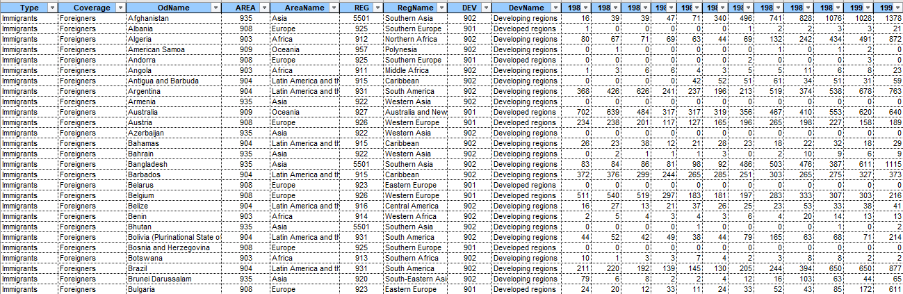
Data Gathering
Data is obtained from Canada immigration
Several columns are identified : Type, Coverage, OdName, Area, AreaName, REG, RegName, DEV, DevName, and Year (1980 – 2013)

Slide 4
Data Preparation
Important columns are selected
Column | Description
Coverage | Identify citizenship status as Immigrant or Foreigner
OdName | Name of country
AreaName | Name of continent
DevName | Identify countries’ status as developed or developing country
Year | Year
NumOfImm | Number of Immigrants

Slide 5
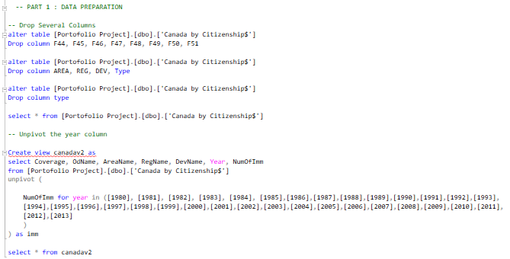
Data Preparation
Several columns are being unpivotted

Slide 6
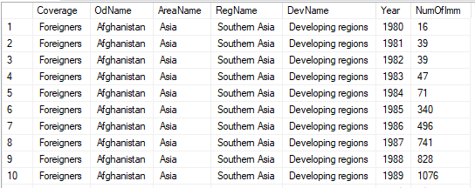
Data Preparation
Results are shown below :

Slide 7

Descriptive Analysis

Slide 8
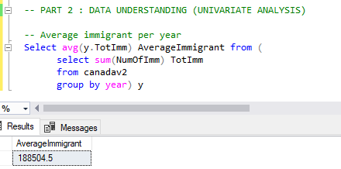
Univariate Analysis
How much average immigrant per year that migrates to Canada?
Conclusion = 188505 immigrant per year

Slide 9
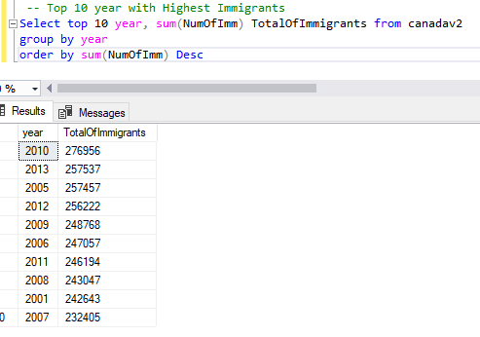
Univariate Analysis
Top 10 year that has the highest number of immigrants
Conclusion : Year 2010 has the highest number of immigrants which reach up to 276956 people

Slide 10
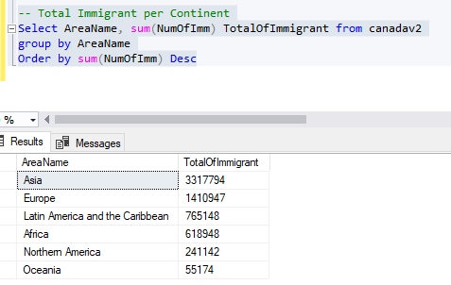
Univariate Analysis
Total Immigrant per Continent
Conclusion : Canada has the highest number of immigrants from Asia which reaches up to 3317794 lives in the range of 1980 - 2014.

Slide 11
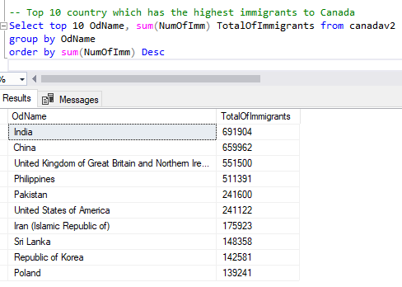
Univariate Analysis
Top 10 country that has the highest immigrants that migrates to Canada
Conclusion : Canada’s immigrants has mostly originated from India which reaches up to 691904 lives in 1980 - 2014

Slide 12

Visualization

Slide 13
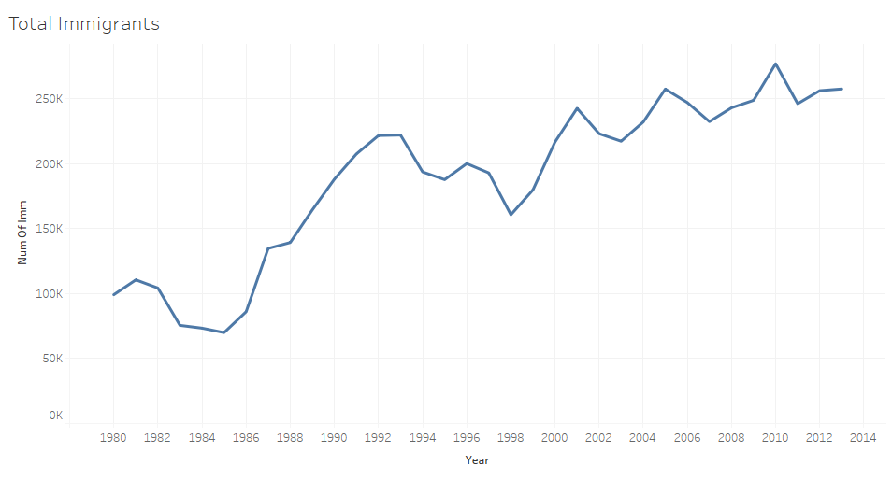
Total Immigrants Line Graph
The Line graph shows that the total amount of immigrants tend to increase

Slide 14
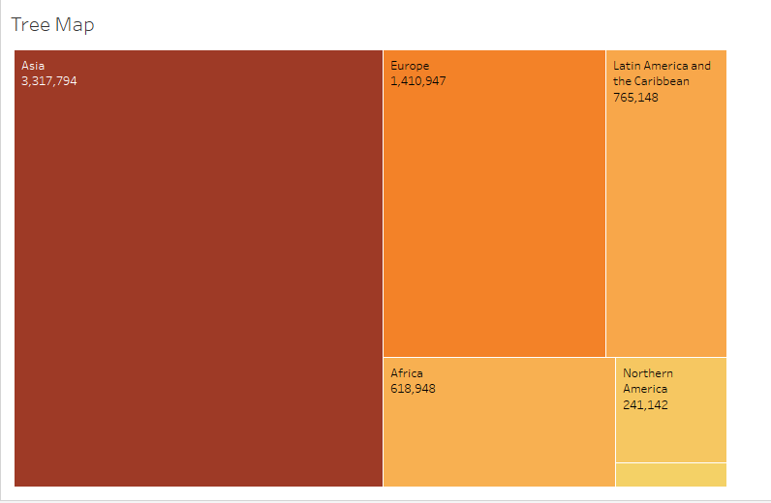
Total Immigrants Tree Map
The tree map besides shows that the majority of immigrants are from Asia, which reaches up to 3,317,794 lives (1980 – 2014)

Slide 15
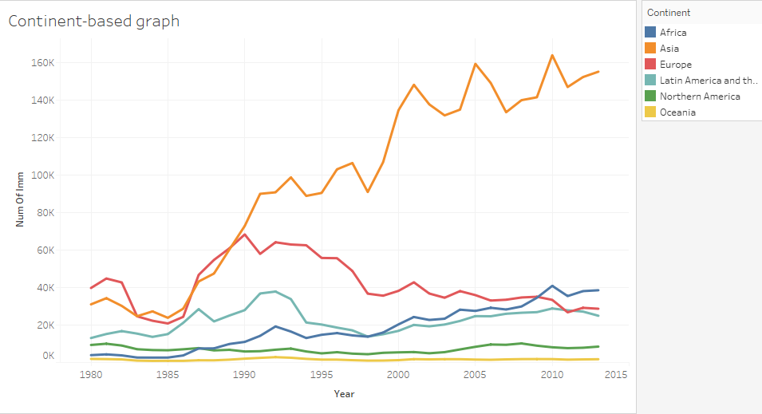
Total Immigrants (Continent-based)
The line graph besides shows that Asian immigrants tend to keep increasing after 1995 when compared to other continents

Slide 16
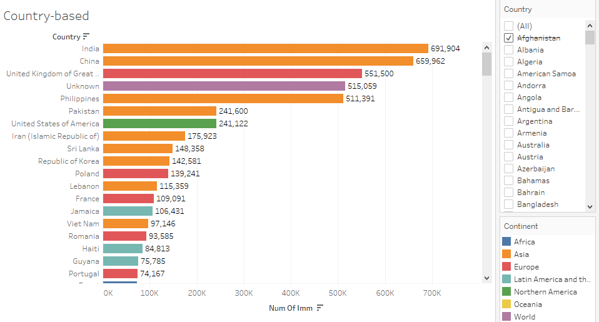
Country-Based Bar Chart
The bar chart besides shows the highest amount of immigrants originates from India

Slide 17
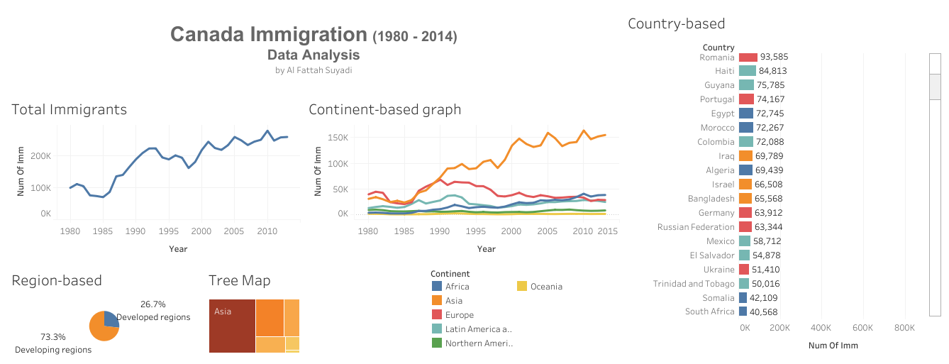
Dashboard
Link : https://public.tableau.com/views/DataAnalystPortofolio01CanadaImmigration/Porto01CanadaImmigration?:language=en-US&publish=yes&:display_count=n&:origin=viz_share_link

Slide 18
Recommendation
Canada should limit the amount of immigrants from every country with certain kuotas
Additional data is needed such as gender, religion, age, and job to obtain more reliable insights

